Slide 1
BITS ZG553: Real Time Systems L15 – Verification & Validation Techniques
K G Krishna
WILP Division, BITS-Pilani, Hyderabad

Slide 2
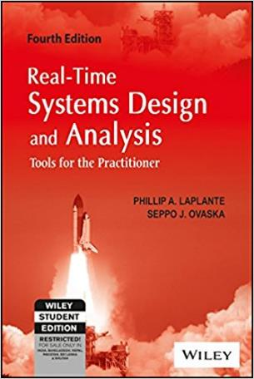
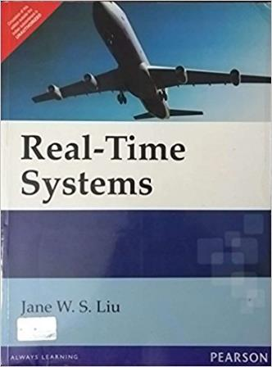
Text Book / References
Reference (R1)
Text Book (T1)
Note: As the above two books focus on theoretical treatment of the subject, Students are strongly advised to refer to web sources / MOOCs videos / library within their own organizations for more practical understanding of the topics.

Slide 3
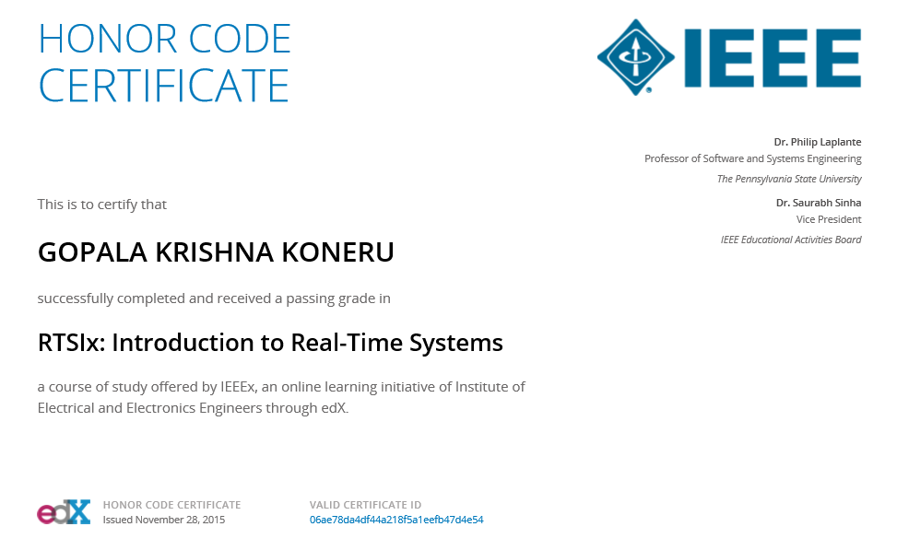
Excellent MOOCs Videos
(Coursera, edX,…)

Slide 4
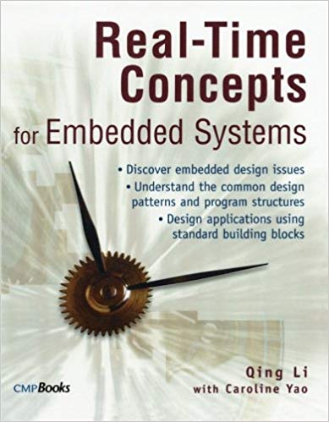
RTS Primer – For Light Reading

Slide 5
L-15: Verification & Validation Techniques
[Ref: R1/C7 & C8]
Note: Students are requested to NOT to rely on PPTs/Recorded sessions as their only source of knowledge, explore sources within your own organization or web for any specific topic; attend classes regularly and involve in discussions;
PLEASE DO NOT PRINT PPTs, Save the Environment!
Source PPT Courtesy: Some of the contents of this PPT is sourced from Presentatoons of Prof K R Anupa / Prof B Mishra, BITS-Pilani WILP Division

Slide 6
The role of testing
Testing is the process of exercising a program with the specific intent of finding errors prior to delivery to the end user.
A good test case is one that has a high probability of finding an error.
A successful test is one that uncovers an error.
The purpose of testing is also to address various aspects of qualities like
Errors
Performance
Reliability etc

Slide 7
Testing real-time software

Slide 8
Testing principles
All tests should be traceable to requirements
Tests should be planned long before testing begins
Testing should begin “in the small” and progress toward testing “in the large”
Test to also improve quality, not just demonstrate correctness

Slide 9
Quality Assurance Activity Sequence
Code Review
Unit Testing
Integration Testing

Slide 10
Code Review
The purpose of code review is to
Find bugs
Suggest code restructuring for better maintainability, readability etc
Improve performance
….
It is performed before Integration / Testing
More eyes may catch more issues
Input to Code Review
Coding Guidelines
Willingness to participate in code review
Incorporating time for code review in the plan

Slide 11
Unit level testing
Several methods can be used to test individual modules or units
Include black and white box techniques
Black box techniques include
exhaustive testing
boundary value testing (boundary value analysis)
random test generation
worst case testing
White box techniques include
judicious test selection
formal program proving
code inspections

Slide 12
System-level testing
Top-down testing
Start with high-level system and integrate from the top-down replacing individual components by stubs where appropriate
Bottom-up testing
Integrate individual components in levels until the complete system is created
In practice, most integration involves a combination of these strategies

Slide 13
Development and QA Activities should be in parallel
Development Track
QA Track
Architecture
Test Plan / Test Bench Architecture
Design
Test Cases Design / Test Bench Design
Development
Test Bench and Test Case development
Integration/Bug fixing
Testing
Release

Slide 14
Continuous integration
Nightly Build at the Server
Automatic Execution of Test Cases at the Server
Integration of the Incremental Code Change to the Codebase
Automated Intimation of Test Results to the Developers
Code Review of the Incremental Code Change
Developer fixes the issues, if any

Slide 15
Thank You.
Any Questions?

